Slide 1


Chaos Engineering on Kubernetes
Team Chaotic Kubes
Rutvi Patel
Bryan Linares
CECS 574 Fall 2023

Slide 2

Problem
DevOps perspective
Inability to access Client environment
How to create problems? When everything is working great?
Accepting Blind Spots

Slide 3
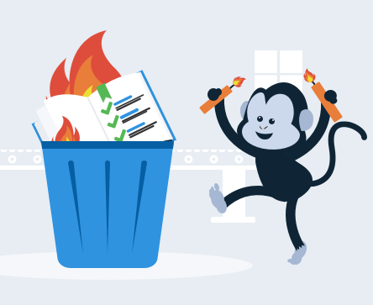
We Need Chaos Engineering!
Test Chaos before an actual chaos occurs (nobody likes 5am calls)
Chaos Engineering is to distributed software systems what crash tests are to the car industry.
Core goal is to test resiliency: which covers reliability availability, integrity and fault-tolerance

Slide 4

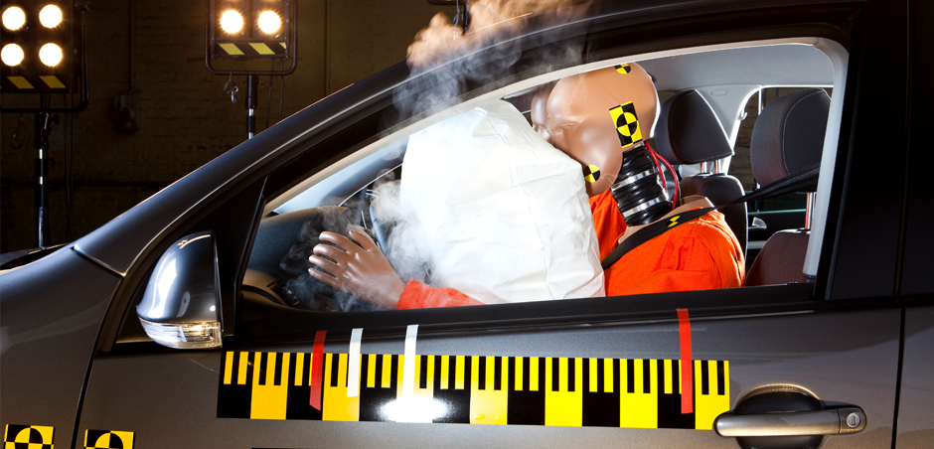

Agenda
Ideas behind Chaos Engineering
Kubernetes Review
Demo Litmus
Demo Chaos Toolkit
Future Outlook

Slide 5
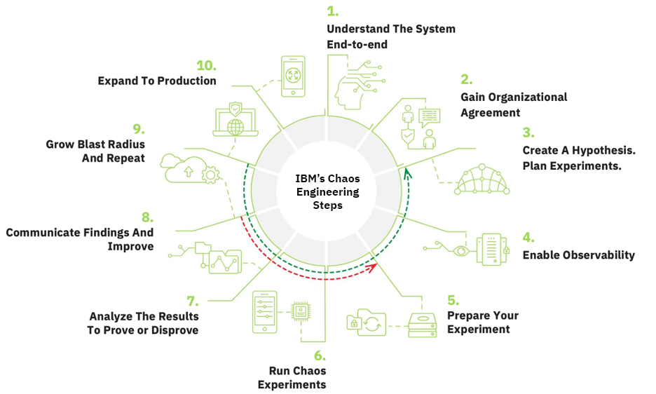
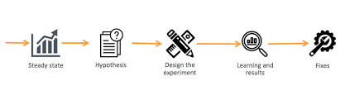
Defining the Chaos Engineering Steps

Slide 6
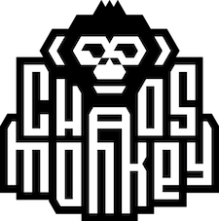
Overview and History of Tools
The goal of Chaos Engineering tools is to take the theory and apply a practical system with it
There are a variety of tools that work with Kubernetes. Most popular began at Netflix.

Slide 7
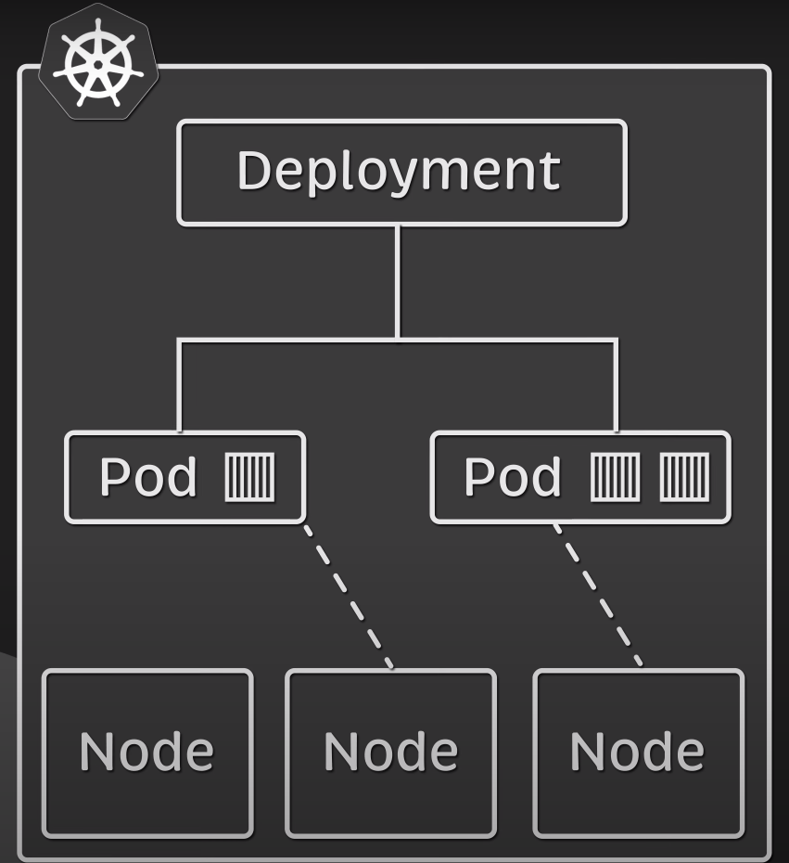
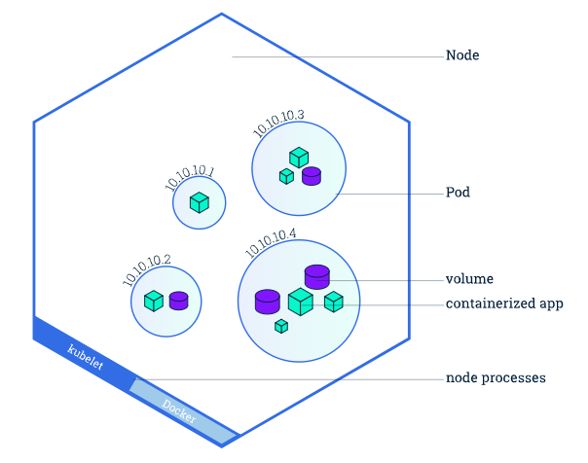
Kubernetes Review

Slide 8

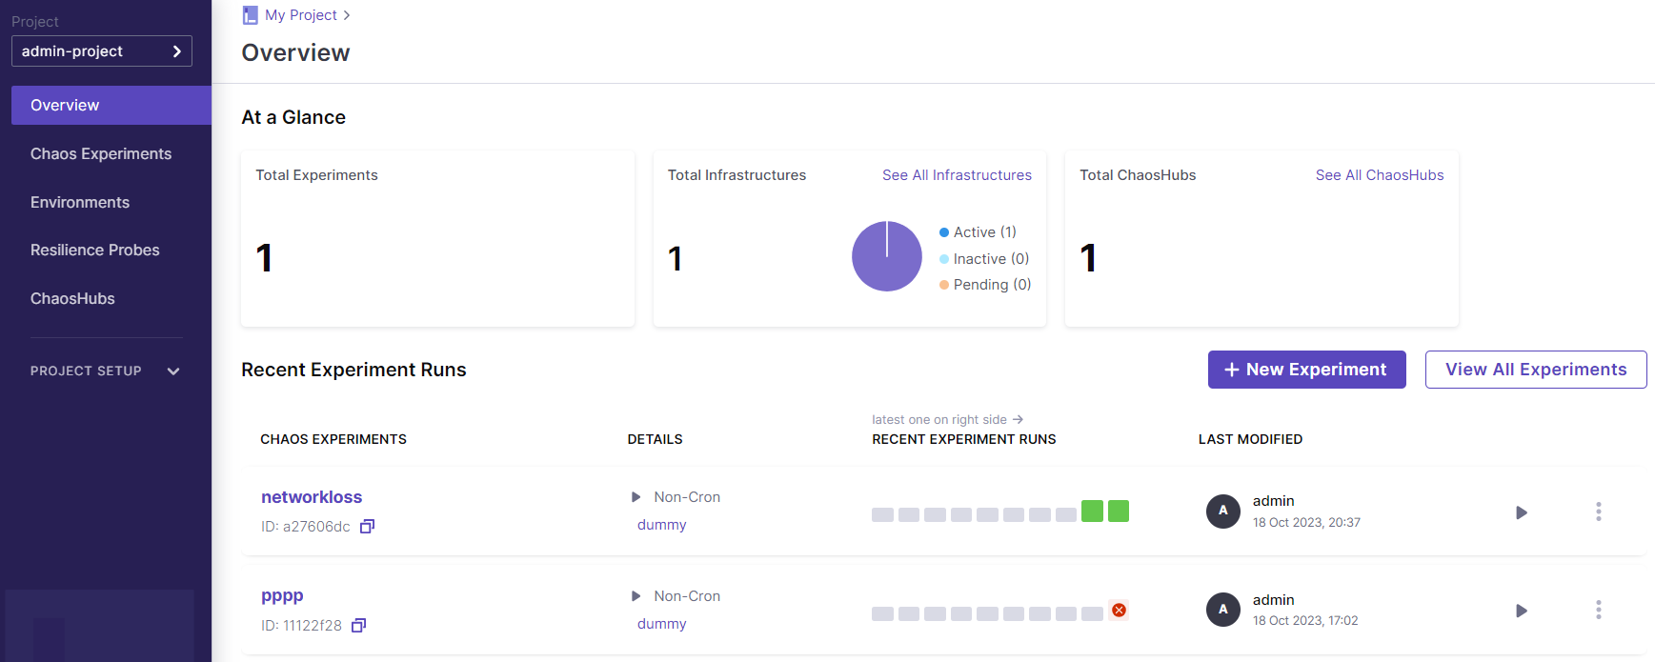
Demo: Litmus
Provides on-demand chaos by stimulating issues that can occur in Cluster/environment.
Framework for conducting Parallel, Sequential, and Chained experiments.
Litmus Hub has 58 different Experiments.

Slide 9
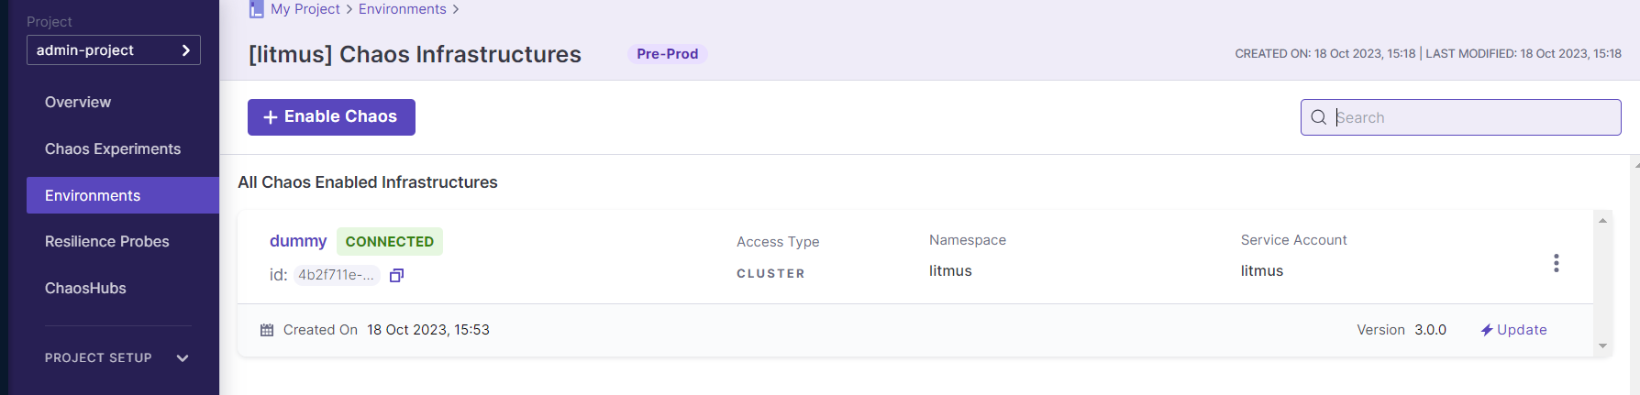
Creating Environment
Litmus requires you to 1st create new Environment in order to get started.
You can then upload or create new deployment/Infrastructure within your environment.
One Environment can have multiple deployments.
Good Usecase: Creating an Environment per Client.

Slide 10
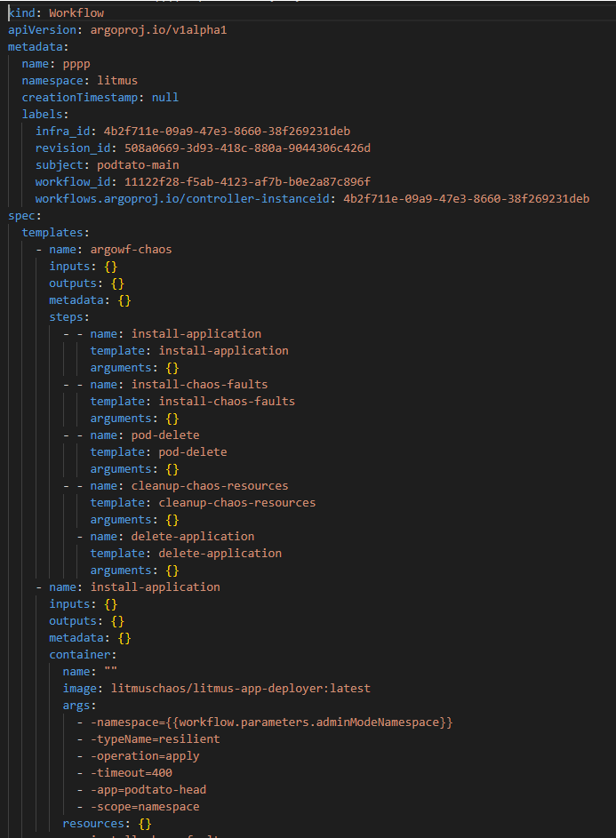
Creating Workflow
Specify all the experiment requirements and processes in YAML file.
Running this configs will create new pods for experiment and the application installed.
You can be as creative with this step to accomplish your hypothesis.

Slide 11
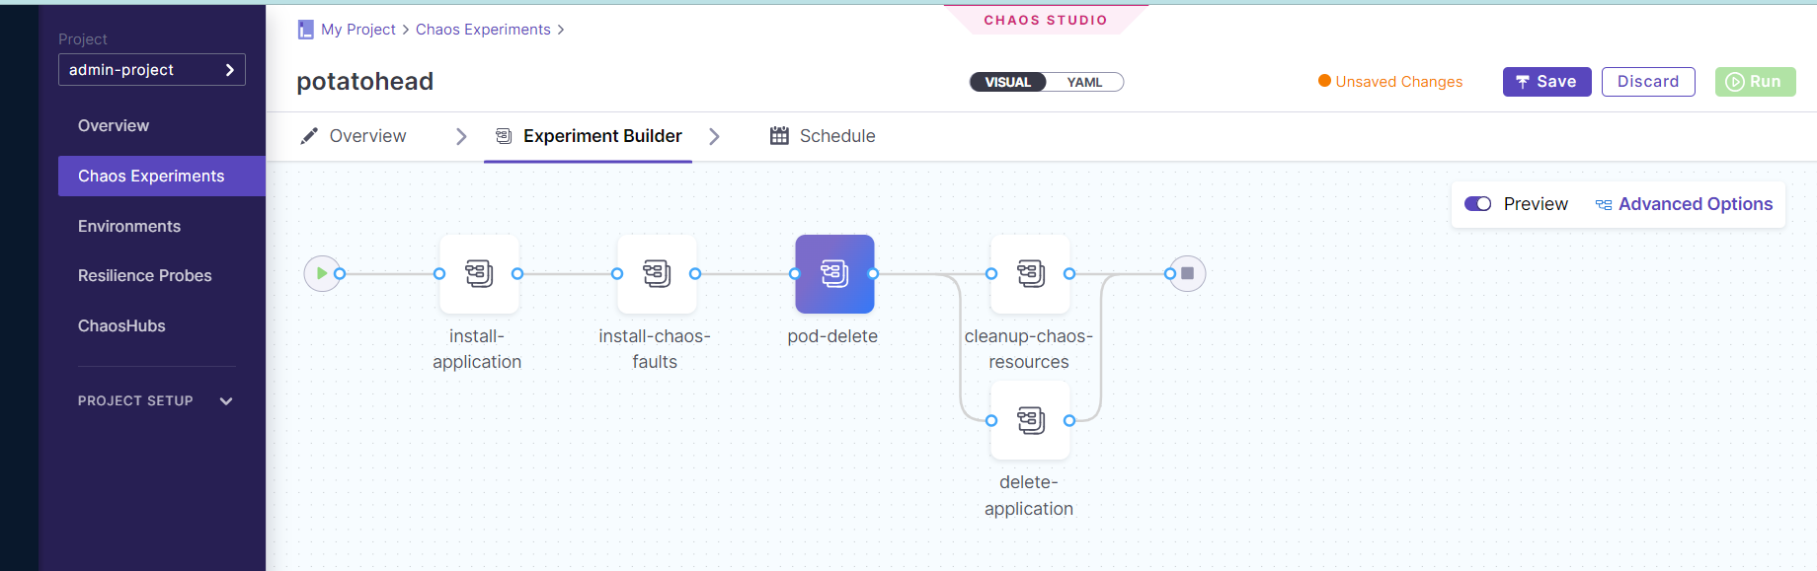
What is POD Delete Experiment?
Pod delete is a Kubernetes pod-level chaos fault that causes specific (or random) replicas of an application resources to fail forcibly (or gracefully).

Slide 12
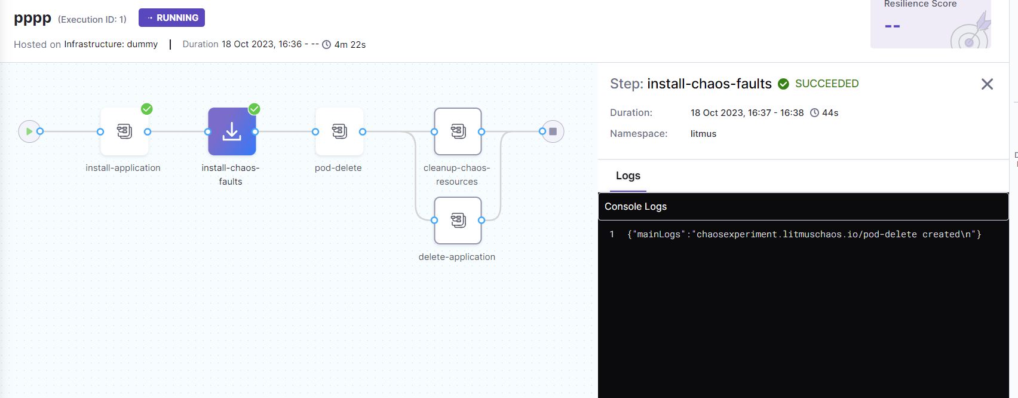
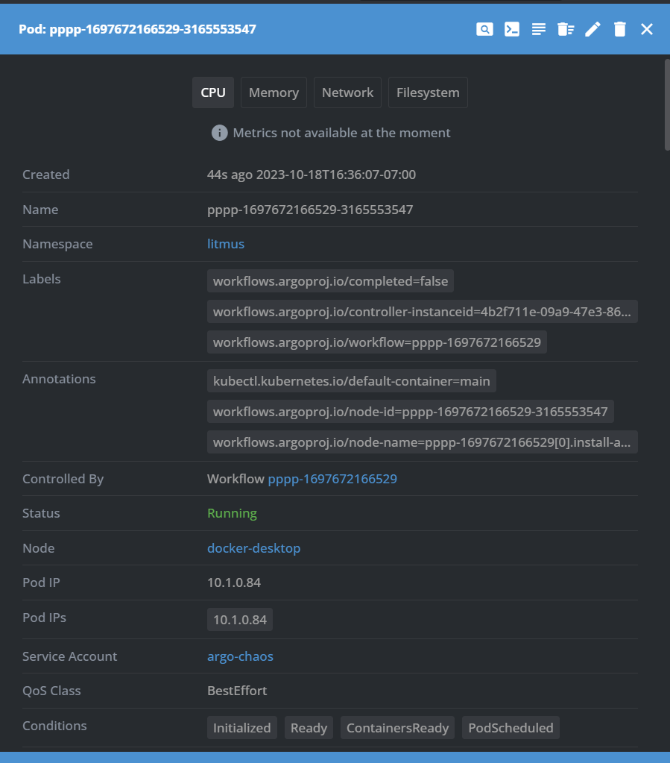
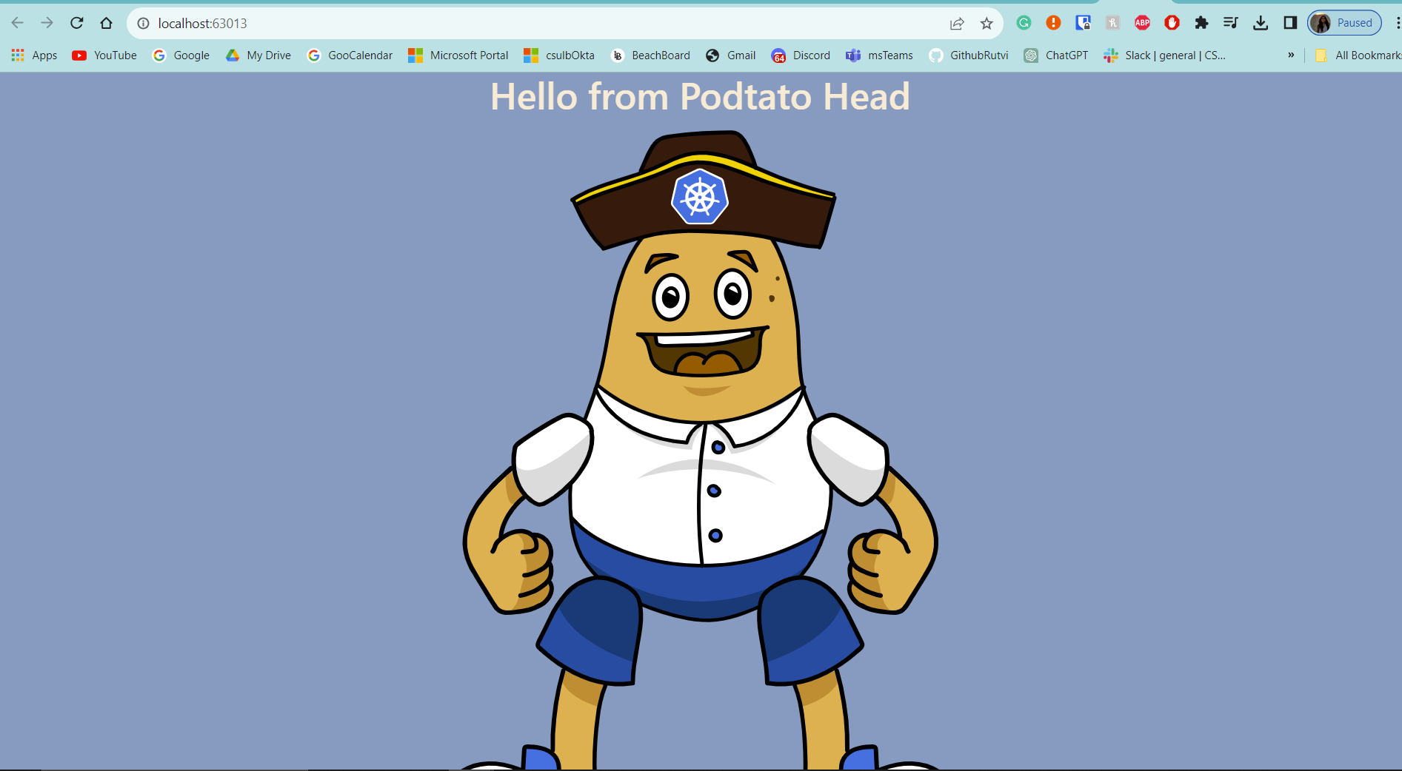
Step 3: Running Application PotatoHead

Slide 13
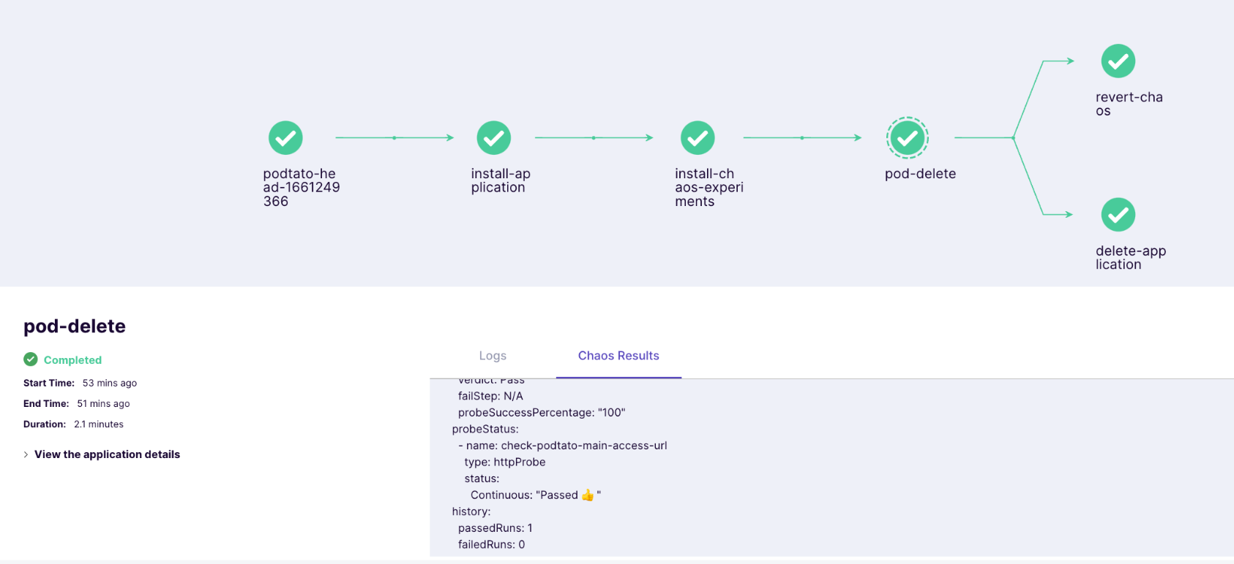
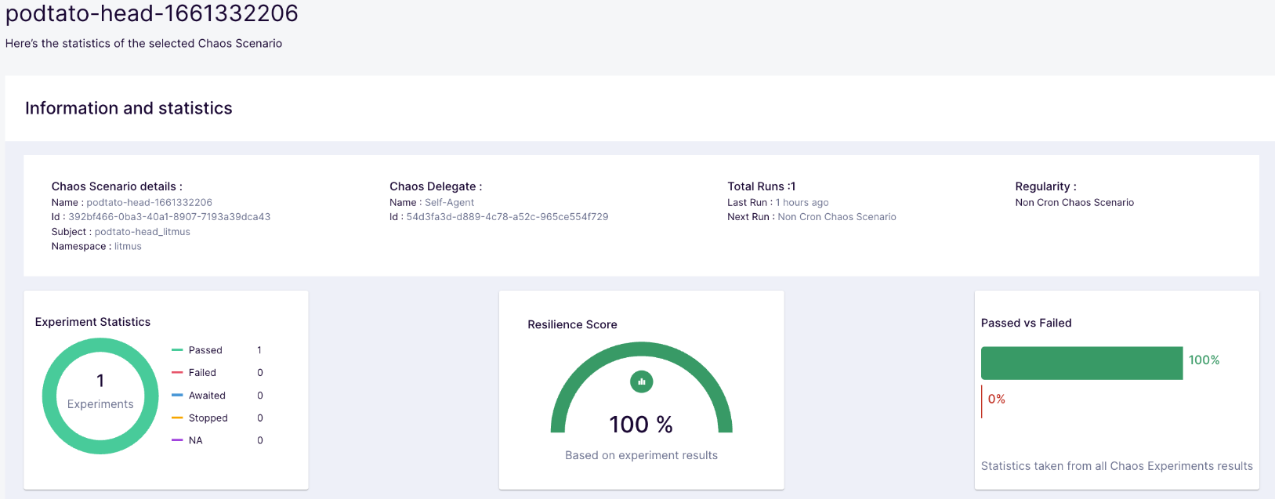
Step 4: Analyzing Test Report
Pod-delete Experiment Completed Successfully
Resiliency Score of 100%
Status: Continuous Pass for the duration of 21 minutes.

Slide 14
Behind The Scenes
Perquisite Installations: Docker, kubectl, Lens, Helm, Minikube, Litmus, Grafana, Prometheus.
Steps Taken for Potato Head:
Creating PotatoHead Application using Python.
Signing up for free account on Litmus Cloud.
Installing PotatoHead on Litmus Cluster
Creating App Image on Docker, using docker command.
Upgrading Litmus agent pods on my cluster using Helm.
Writing Delete-Pod Experiment yaml file and running it using Litmus UI.
Creating Kubernetes Cluster using Minikube.
Integrating my cluster with Litmus UI. My cluster should show up connected under Environments.
In Progress: Setting up Grafana and Prometheus url under Litmus Probes.

Slide 15
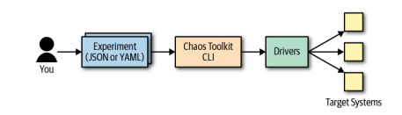
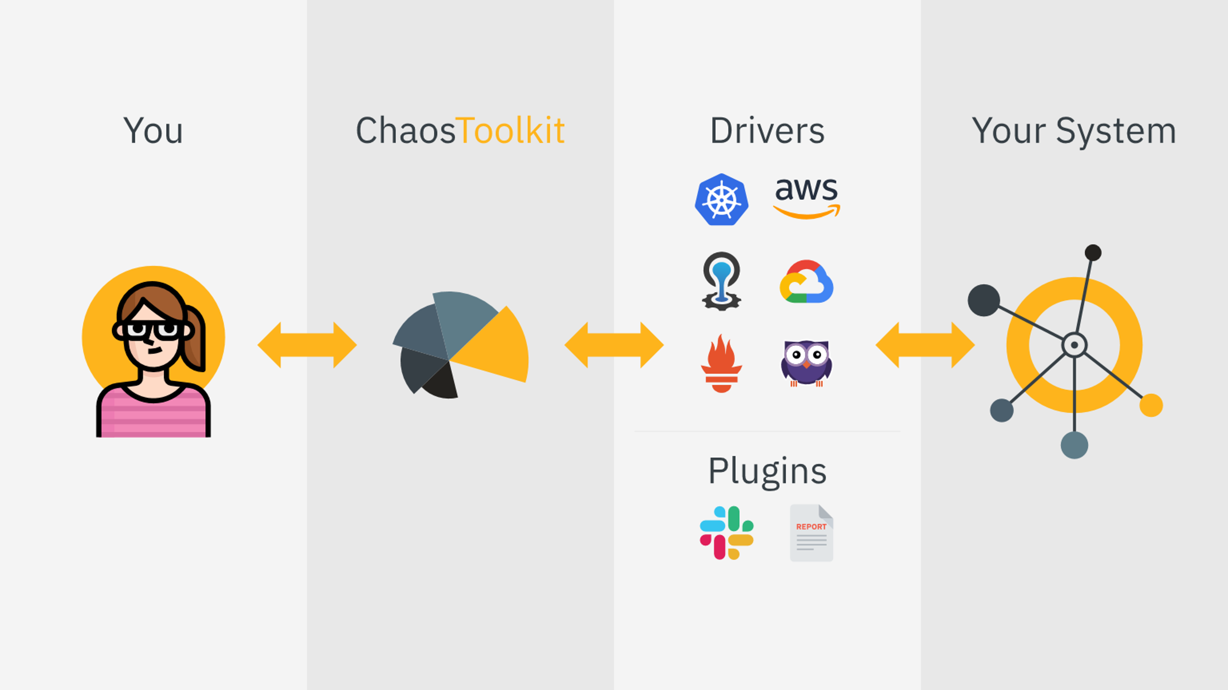
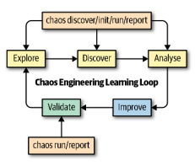
Demo: Chaos Toolkit

Slide 16
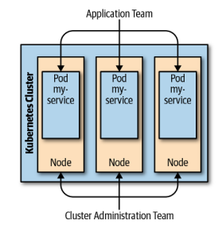
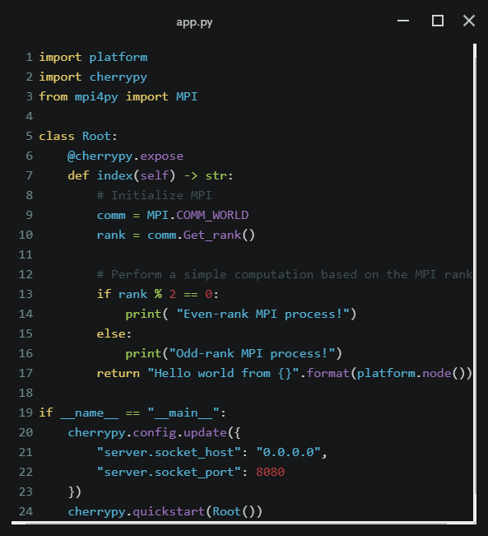
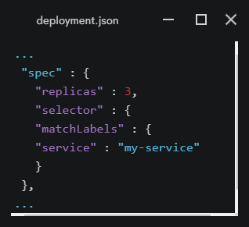
The Target System

Slide 17
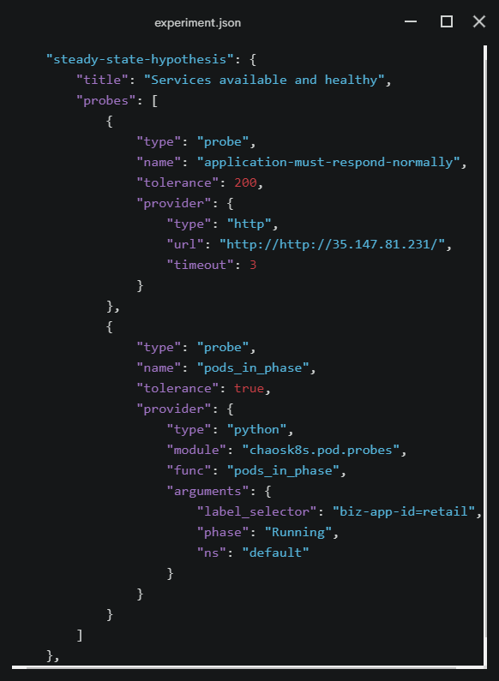
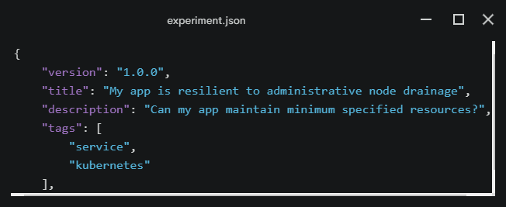
Making the Experiment

Slide 18
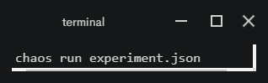
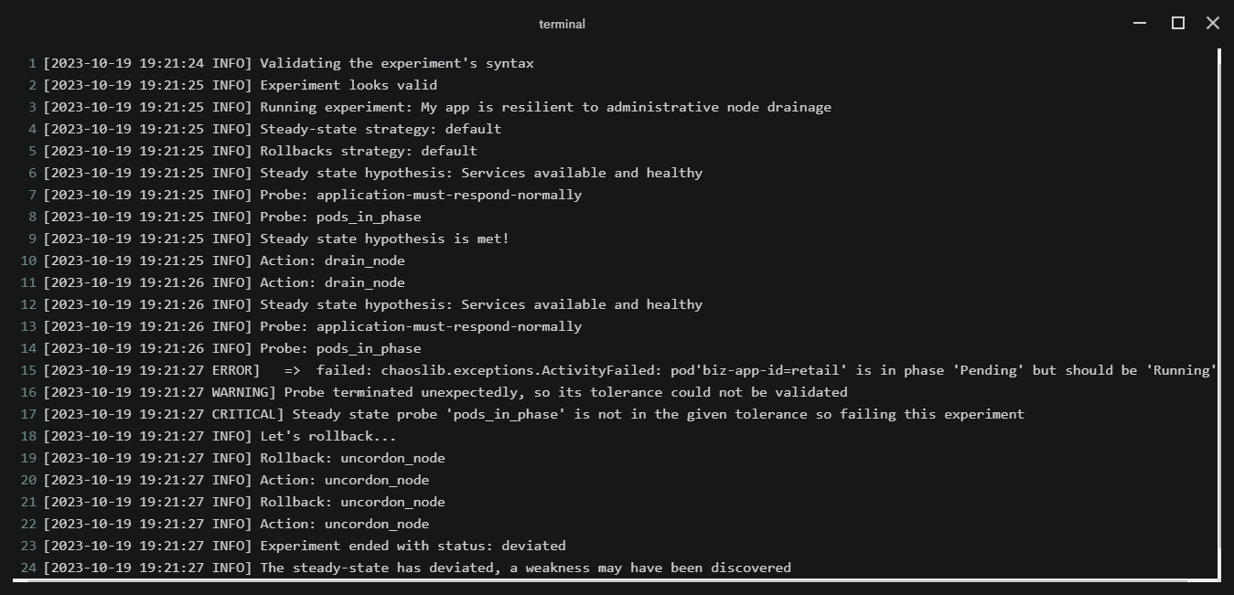
Executing the Probe and Actions

Slide 19
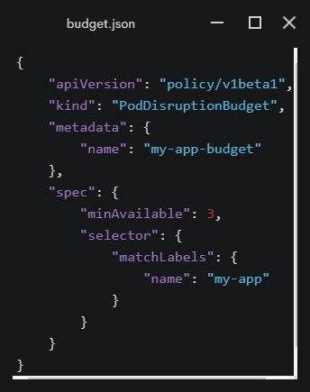
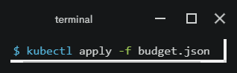
Applying a Fix
Explore available Kubernetes functions, ex. Kubernetes Pod Disruption Budget

Slide 20
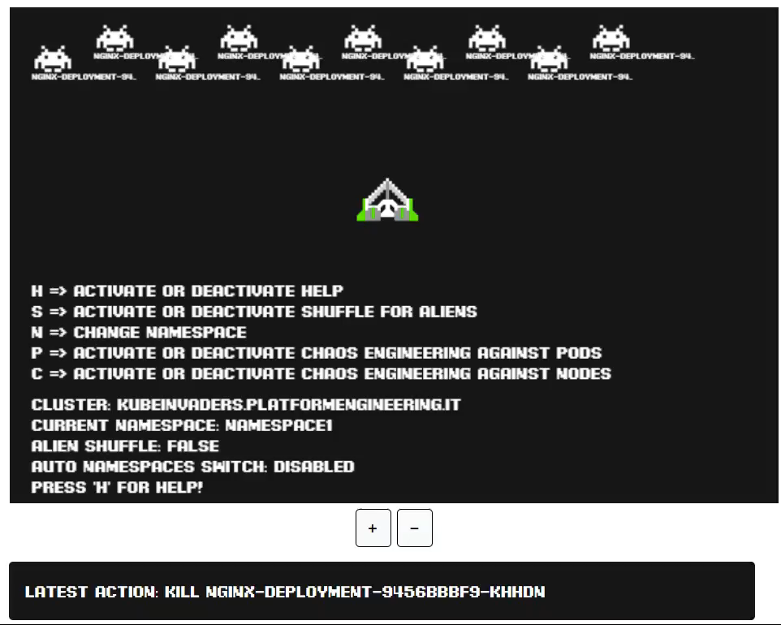
KubeInvaders: Delete-Pod Experiment

Slide 21
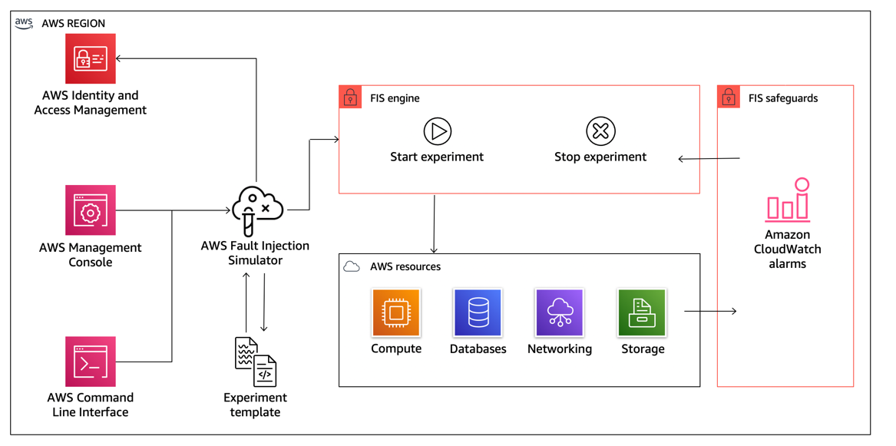
Future Outlook and other Tools
Most companies put these tools under DevOps and Reliability Engineers
They tend to use their preferred processes and complexities

Slide 22


Thank You, Questions?
Team Chaotic Kubes
https://github.com/Rutvi-Patel/Kubernetes-Chaos-Engineering

